Slide 1
Compton Scattering
Alejandro Legarda

Slide 2
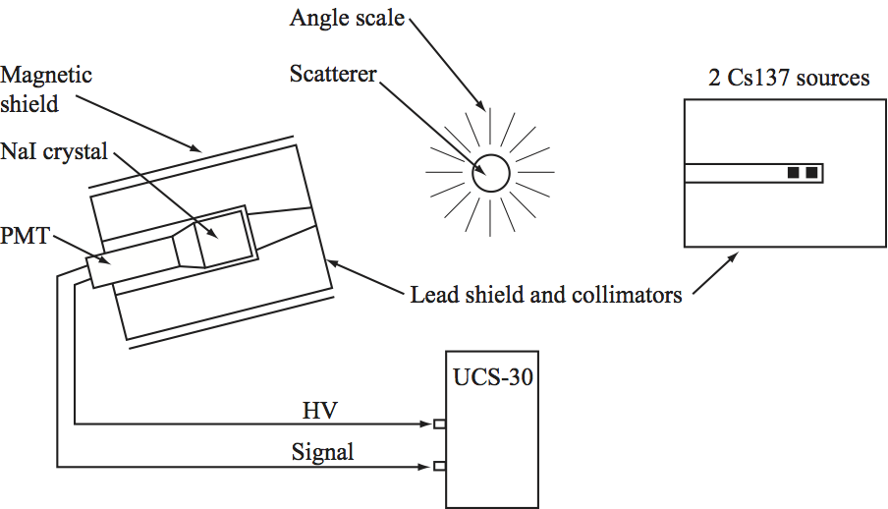
Apparatus

Slide 3
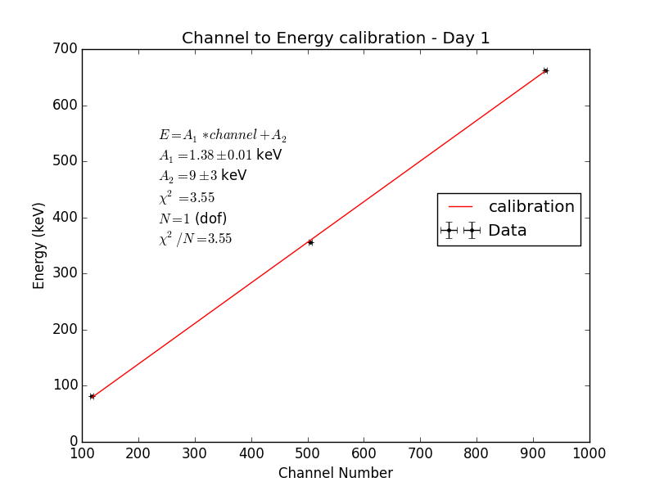

Slide 4
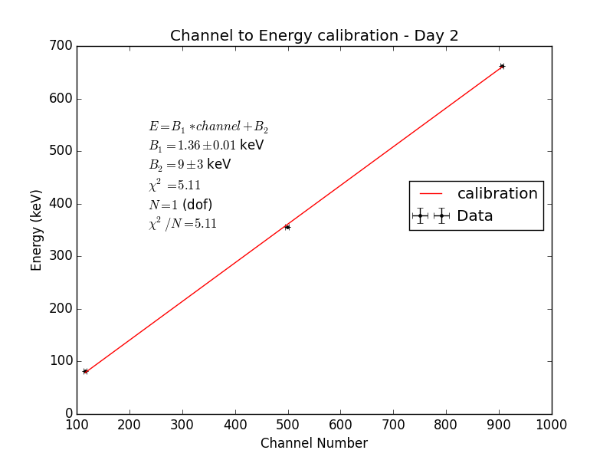

Slide 5
